Slide 1

PRESENTATION
CV Website

Slide 2
Agenda
Knowledge get form HTML & CSS
Solution that using
Some tip to be build great website

Slide 3
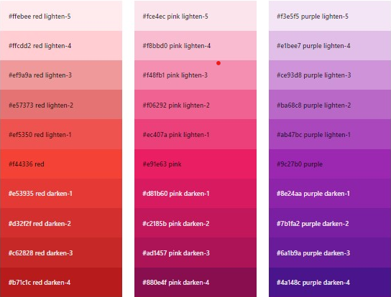
Knowledge get from HTML & CSS
Color

Slide 4
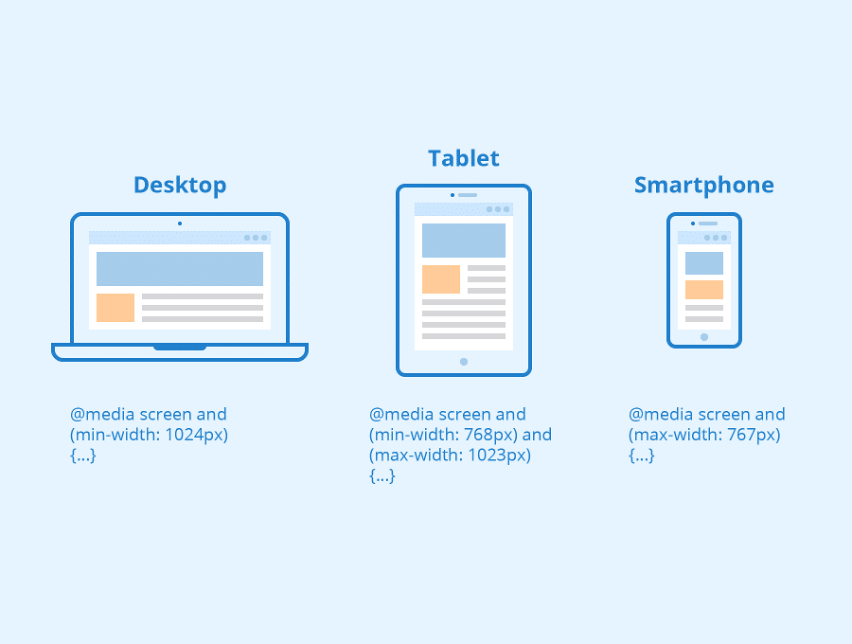
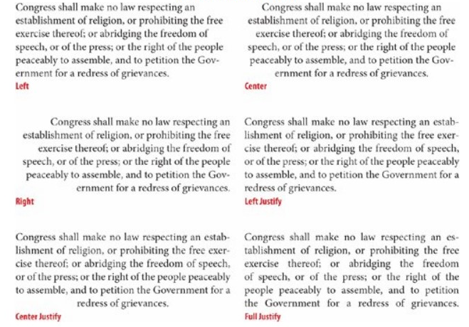
Knowledge get from HTML & CSS
Responsive
Text

Slide 5
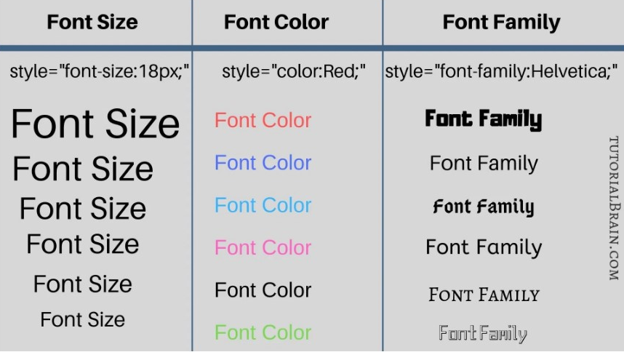
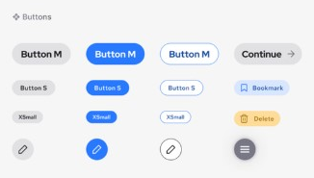
Knowledge get from HTML & CSS
Component
Font

Slide 6
2. Solution that using
Try to ask question to teacher more
Build more commitment
Try more to researching

Slide 7
3. Some tip to be build great website
Keep the design simple, fresh and unique.
Content is critical.
Consider that your visitors might be visiting from laptops, tablets and mobile phones.

Slide 8
THANK YOU

